Slide 1
WALT
Private tap-to-pay for Android
Pre-Seed Investment Opportunity
walt.is

Slide 2
The Problem
Your daily spending reveals who you are.
Google Wallet by the numbers:
Every tap-to-pay transaction on an Android phone routes through Google Wallet. Google harvests this data along with Google Search, Gmail, Calendar, Google Maps data to build intimate profiles of your life, values, and future behavior.
520M
users worldwide
$5.2T
processed annually
"To know what you spend your money on each day is also to know what you will spend your money on each day."
55B
contactless card payments in Europe
Sources: Coinlaw research, European Central Bank

Slide 3
No Alternatives Exist
For Android users who want tap-to-pay without surveillance, current options are:
Switch Ecosystems
Go Backwards
Accept It
Buy an iPhone or Samsung. Expensive, inconvenient, and still involves other data-hungry companies.
Use cash or physical cards. Lose convenience, risk loss/theft, carry more items.
73% of US consumers feel they have no control over how companies use their data.
Android holds 71% of the global smartphone market.
There is no privacy-preserving tap-to-pay option for Android.
Sources: Pew Research, Exploding Topics

Slide 4
The Solution
Walt is the private alternative to Google Wallet.
PHILOSOPHY
No AI. No premium features. There's only one user flow that matters. Load a card, set Walt as default wallet, start tapping to pay.
A tap-to-pay wallet for Android that treats transaction data as sacred. No collection. No storage. No selling.
1
Transaction data stays encrypted on your device
2
No server-side transaction storage
Deliberately simple. Intentionally focused.
3
Funded by users, not data monetization

Slide 5
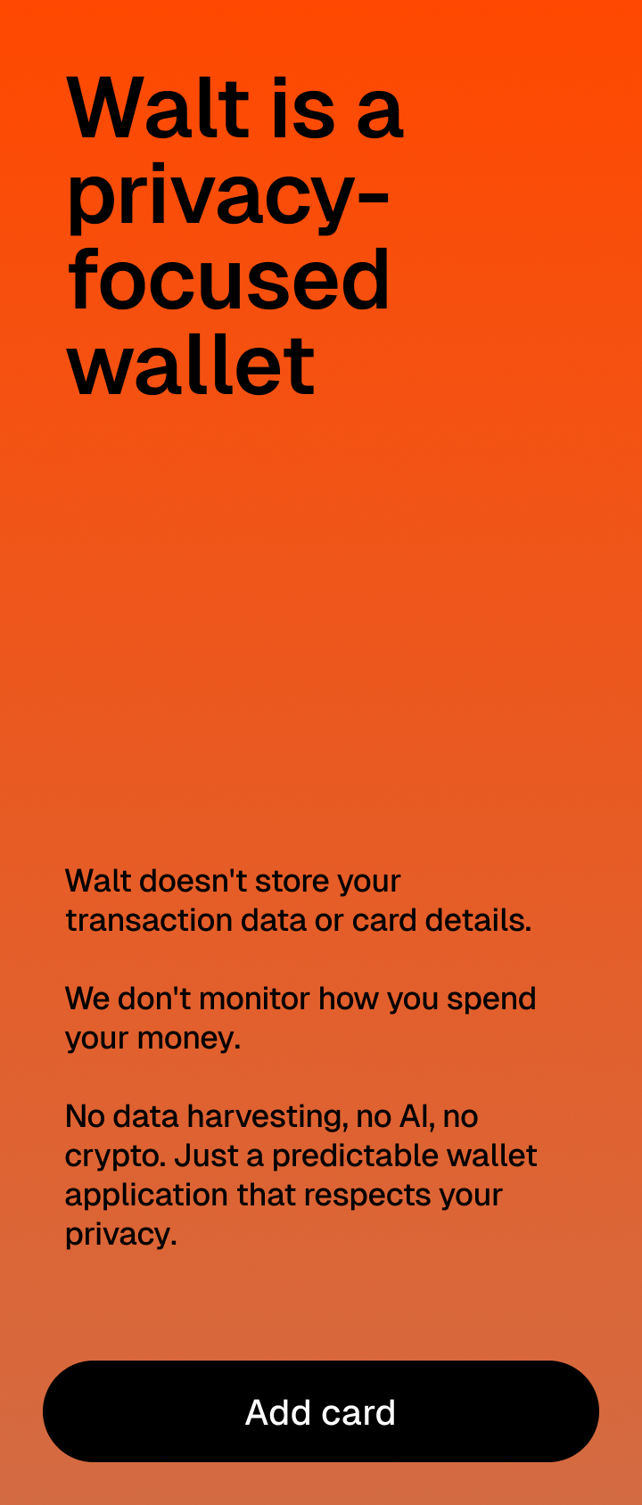
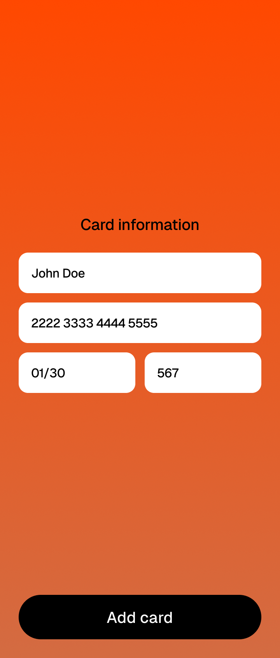
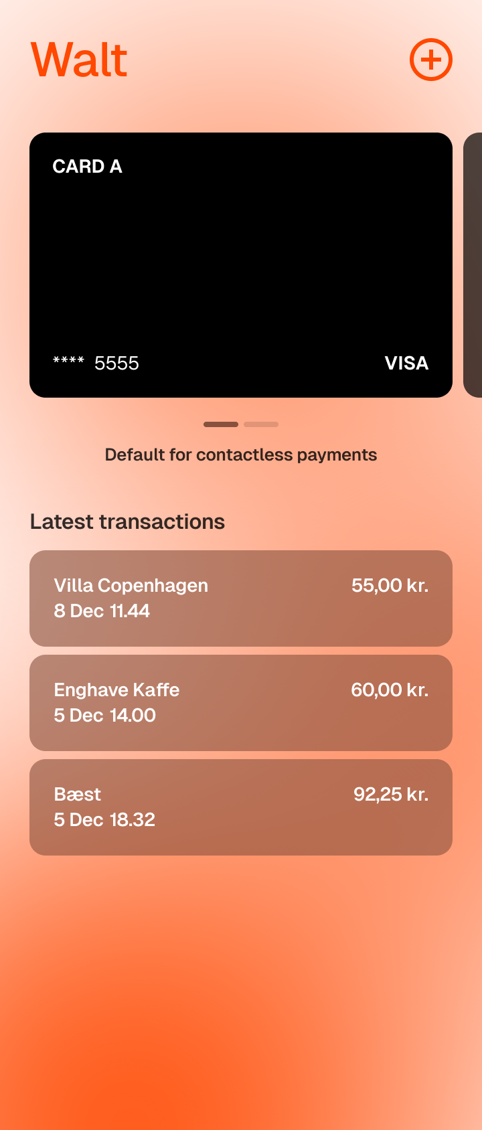
Product
Simple and straightforward. A predictable, familiar wallet app.
Download
Add Cards
Tap to Pay
Once generally available
Enter card details. Everything stays encrypted locally. Unencrypted card details never leave your device.
Hold your phone near any NFC terminal. Same predictable experience you're used to with Google Wallet or Apple Pay.

Slide 6
Why Now?
PRIVACY AWARENESS SURGING
TAP-TO-PAY EXPLODING
LEGISLASTION
300K+
91%
Digital Markets Act
r/degoogle members with 8K weekly conversations
of UK 25-34 year-olds use contactless regularly
Prior to July 2024, it was not possible to build a replacement for Google Wallet.
Privacy Alternatives Winning
Google Search competes with DuckDuckGo, ChatGPT
The Gap
Every major Google product has a privacy-focused competitor. However, competition was for Google Wallet was only unlocked in late 2024.
Gmail competes with ProtonMail, Hey.com
Chrome competes with Firefox, Brave
Sources: European Central Bank

Slide 7
Market Size
TAM - TOTAL ADDRESSABLE MARKET
$18.7B
Global mobile wallet market (2024)
Market Tailwinds
71% global smartphone market is Android
EU digital payments growing 15% annually
Pro-privacy, anti-US sentiment in EU
SAM - SERVICEABLE ADDRESSABLE MARKET
$4.2B
European Android tap-to-pay users
520M Google Wallet users
SOM - SERVICEABLE OBTAINABLE MARKET
All potential Walt converts
$21M
5% of European Android users willing to pay for privacy

Slide 8
Team
Key Hire
Cole Bittel
1. BDR / Partnerships
CB
Founder
Unlocking relationships with banks, enabling bank cards across Europe to be loaded into Walt.
DevOps and Infrastructure Engineer Former: Pleo, Funding Circle Current: Legora
2. Marketing
Embedded Engineering ApS | Copenhagen, Denmark
Publicizing Walt on Proton, Signal, Brave, and other anti-Google product alternatives.
linkedin.com/in/bittelc

Slide 9
Business Model
Simple pricing that replaces the hidden cost of ad-based wallets.
Why Subscription?
No Premium Model
$3
Aligns incentives with users. Straightforward relationship between customer and company.
Expanding the product to include more features and a premium model bloats the target of the product and reduces the trust relationship the product is founded on.
/month
Where It Goes
Salary - Founder and BDR / partnerships hire
Aggregator fees- Aggregator (Paymentology) fees based on monthly active users.
Privacy you can trust, funded by users who value it.

Slide 10
Traction & Roadmap
H2 2025
Q1 2026
Q2 2026
Foundation
Partnerships
Launch
Public waitlist live. Aggregator partnership with Paymentology in place. Android application ready for card loading once banks are unlocked.
Find co-founder. First bank contract to unblock card loads.
First cards loaded. First transactions processed. Geographic expansion begins.
Current Progress
Key Challenges Ahead
Paymentology partnership for aggregator
Android application ready for beta group testing
Public website and signup list created
First bank partnership
Legal signoff from Visa and Mastercard
First card load onto Walt

Slide 11
The Ask
Use of Funds
PRE-SEED ROUND
Business Development Hire
50%
$500K
Aggregator Fees
25%
Founder Salary
15%
18 months runway
Marketing
10%

Slide 12
WALT
"Transaction data is sacred."
Cole Bittel, Founder
cole@walt.is
walt.is
Embedded Engineering ApS | Copenhagen, Denmark

